Slide 1
Sectoral Innovation System
Most of this lecture is based on:
Pavitt (1984), Sectoral patterns of technical change: Towards a taxonomy and a theory, Research Policy 13

Slide 2

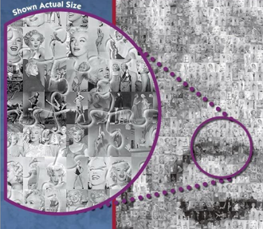
Why Sectoral?
Considerable variety in the sources, nature, and uses of innovations across sectors
Most technological knowledge is specific to firms and applications, developed cumulatively among sectors, rather than information that is generally applicable or easily reproducible

Slide 3
Do Sectors Matter?
Foundations of the sectoral studies of innovation
Long-term evolution of industries (Schumpeter 1942, Kuznets 1930, Clark 1940)
Taxonomy of sectors (Pavitt 1984)
Industry life cycles (Utterback 1994, Klepper 1996)
Patterns of innovation activities and technological regimes (Malerba & Orsenigo 1996)

Slide 4
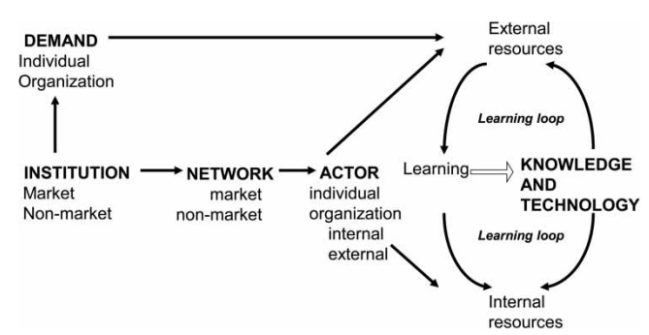
Sectoral Innovation System (Malerba 2002, 2004)
Firms are a part of systems that comprise other actors and institutions.
Firms in industries learn and accumulate capabilities in systems including knowledge and technologies, demand conditions, other actors, and institutions.
Sectoral systems evolve over time through co-evolutionary processes in their elements (Nelson, 1994; Malerba and Adams, 2013)

Slide 5
Pavitt’s Landmark Study Sectoral patterns of technical change (1984, Research Policy)
Data: 2,000 significant innovations of innovating firms in Britain (1945-79)
Grouped into 11 sectors at the 2-digit level and 26 sectors at the 3-digit level
Comparing sectoral patterns of technological diversification in terms of:
Sectoral sources of technology used in a sector
Institutional sources and nature of the technology produced in a sector (esp., intramural vs extramural, product vs process innovation)
Characteristics of innovating firms (e.g. size and principal activity)

Slide 6
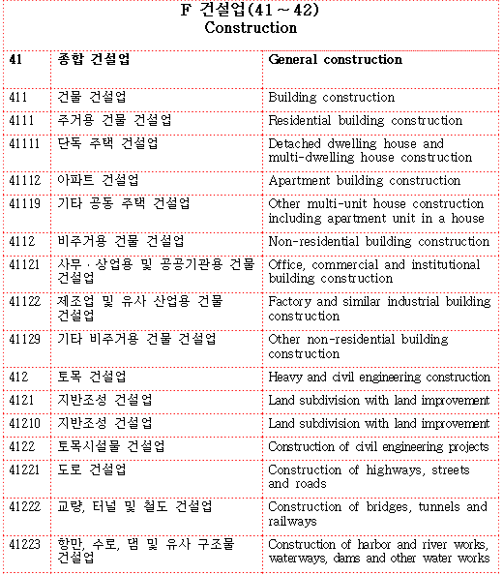
| 한국표준산업분류(KSIC)
유엔 국제산업표준분류를 기초로 통계법 22조에 의거해 작성
63년 광업/제조업, 64년 제조업 이외 부문 산업분류로 시작
분류기준
산출물(생산된 재화 또는 제공된 서비스)의 특성 – 산출물의 물리적 구성, 가공 단계, 수요처, 기능 및 용도
투입물의 특성 – 원재료, 생산 공정, 생산기술 및 시설 등
생산활동의 일반적인 결합형태

Slide 7
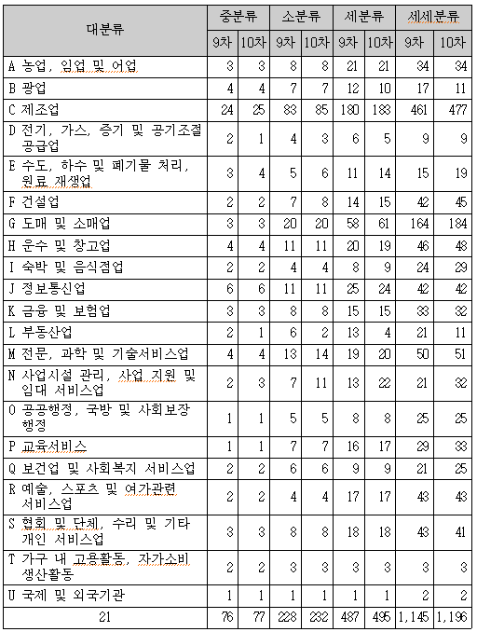
| 한국표준산업분류(KSIC)
최신판 : 2017년 10차 개정
바이오연료, 탄소섬유, 에너지 저장장치, 디지털적층성형기계, 무인항공기 제조업과 태양력 발전업, 전자상거래 소매 중개업 등 신설
반도체, 센서류, 유기발광다이오드 표시장치, 자동차 부품류, 인쇄회로기판 제조업, 대형마트, 면세점, 요양병원 등은 기존 분류체계에서 세분

Slide 8
Sectoral Patterns of Technical Change
Five combinations of sectoral production/use of innovations and the principal activity of innovating firms
Category | Sector of production of innovation | Principal activity of the innovating firm | Sector of use of innovation
1 (e.g., steel making) | O | O | O
2 (e.g., firm making textile machines for textile industry) | O | O | X
3 (e.g., shipbuilding firm developing a special machine tool for use in shipbuilding) | X | O | O
4 (e.g., firm in general chemicals developing a process innovation in textiles) | O | X | O
5 (e.g., firm in electronic capital goods developing innovation in instrumentation for use in motor vehicles) | X | X | X

Slide 9
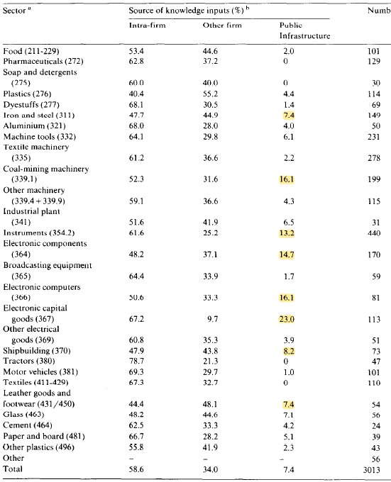
| Sectoral Patterns of Institutional Knowledge Sources
Institutional sources of knowledge inputs
Only 7% coming from public infrastructure vs. 59% from the innovating firms themselves

Slide 10
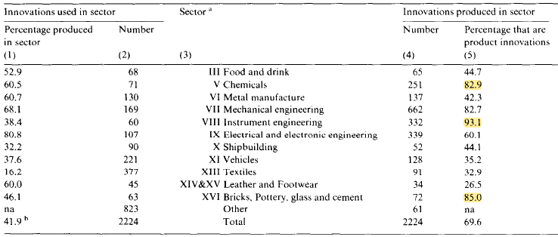
| Sectoral Patterns of Production/Use of Innovations
Product innovations (i.e., used in other sectors) vs. process innovations (i.e., used inside own sector) (Scherer 1982)
Process innovations
Product innovations

Slide 11
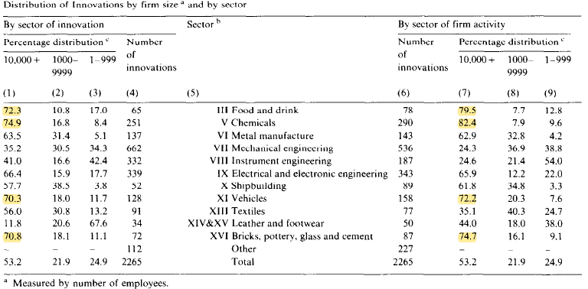
| Sectoral Patterns of Innovating Firms
Size distribution of innovating firms
Large firms making bigger contributions in both: food & drink, chemicals, vehicles
Large firms making bigger contributions by sector of innovation then by firm activity: mechanical engineering, instrument engineering, textiles

Slide 12
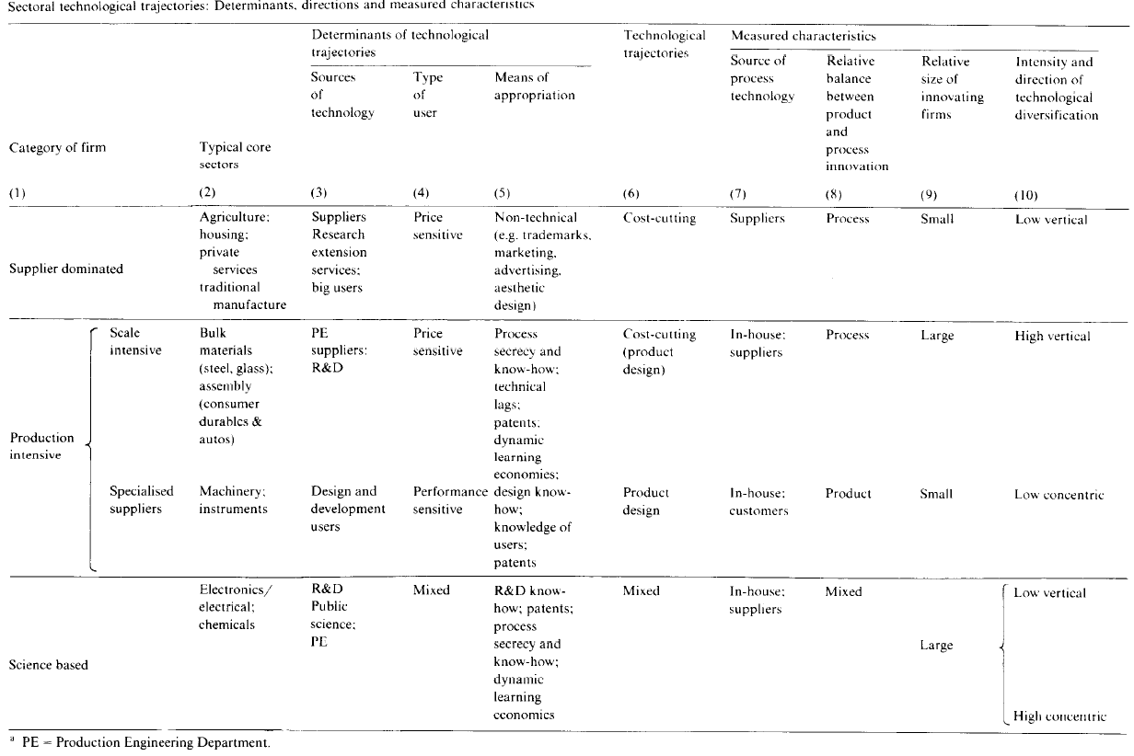

Slide 13
Research Prospectus Draft Presentation & Discussion
Draft in slides due by 10/23/Sunday
Presentation in two classes due to # of students
First presentation on 10/25/Tue (online) – 4 students
Second presentation on 11/1/Tue (offline) – 8 students
Expectations
20 min presentation (roughly 20 slides) and 10 min discussion
Listening students will be submitting comments/questions sheet after class
No restrictions to topic domains but!
Must refer to at least one or more theories/concepts/authors covered in the course

